Slide 1
School of Computing Science and Engineering
Course Code:BTCS2401
Course Name: Computer Graphics
Unit 3
(3D) Three Dimensional
Faculty Name: Mr. Damodharan D
Program Name: B.Tech

Slide 2
Topics to be covered
Unit III:
3-D Clipping
Projection Pipeline

Slide 3
3D Clipping
Just like the case in two dimensions, clipping removes objects that will not be visible from the scene
The point of this is to remove computational effort
3-D clipping is achieved in two basic steps
Discard objects that can’t be viewed
i.e. objects that are behind the camera, outside the field of view, or too far away
Clip objects that intersect with any clipping plane

Slide 4
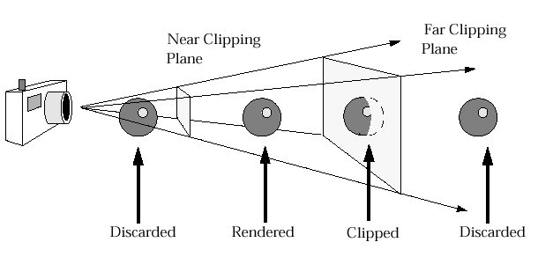
3D Clipping
Objects that are partially within the viewing volume need to be clipped – just like the 2D case

Slide 5
Clipping Algorithms
3D clipping algorithms are direct adaptation of 2D clipping algorithms with following modifications:
For Cohen Sutherland: Assignment of out codes
For Liang-Barsky: Introduction of new equations
For Sutherland Hodgeman: Inside/Out side Test
In general: Finding the intersection of Line with plane.

Slide 6
3D Cohen-Sutherland Line Clipping
Similar to the case in two dimensions, we divide the world into regions
This time we use a 6-bit region code to give us 27 different region codes
The bits in these regions codes are as follows:
bit 1 Above | bit 2 Below | bit 3 Right | bit 4 Left | bit 5 Behind | bit 6 Front

Slide 7
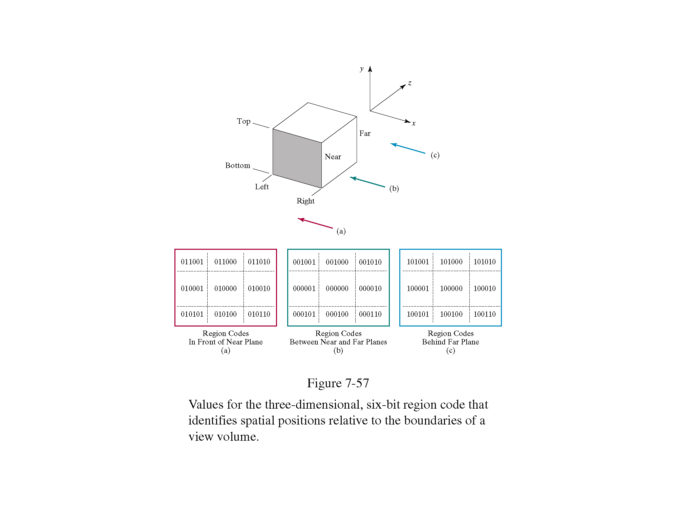
3D Cohen-Sutherland Line Clipping

Slide 8
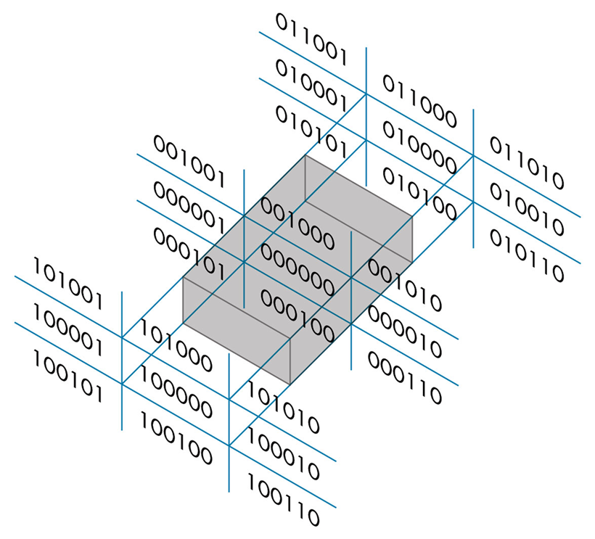
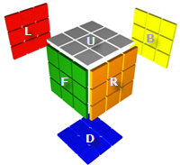
3D Cohen-Sutherland Line Clipping
Now we use a 6 bit out code to handle the near and far plane.
The testing strategy is virtually identical to the 2D case.

Slide 9
3D Cohen-Sutherland Line Clipping
CASE – I Assigning region codes to endpoints for Canonical Parallel View Volume defined by:
x = 0 , x = 1; y = 0, y = 1; z = 0, z = 1
The bit codes can be set to true(1) or false(0) for depending on the test for these equations as follows:
Bit 1 ≡ endpoint is Above view volume = sign (y-1)
Bit 2 ≡ endpoint is Below view volume = sign (-y)
Bit 3 ≡ endpoint is Right view volume = sign (x-1)
Bit 4 ≡ endpoint is Left view volume = sign (-x)
Bit 5 ≡ endpoint is Behind view volume = sign (z-1)
Bit 6 ≡ endpoint is Front view volume = sign (-z)

Slide 10
3D Cohen-Sutherland Line Clipping
CASE – II Assigning region codes to endpoints for Canonical Perspective View Volume defined by:
x = -z , x = z; y = -z, y = z; z = z_{f} , z = 1
The bit codes can be set to true(1) or false(0) for depending on the test for these equations as follows:
Bit 1 ≡ endpoint is Above view volume = sign (y-z)
Bit 2 ≡ endpoint is Below view volume = sign (-z-y)
Bit 3 ≡ endpoint is Right view volume = sign (x-z)
Bit 4 ≡ endpoint is Left view volume = sign (-z-x)
Bit 5 ≡ endpoint is Behind view volume = sign (z-1)
Bit 6 ≡ endpoint is Front view volume = sign (z_{f}-z)

Slide 11
3D Cohen-Sutherland Line Clipping
To clip lines we first label all end points with the appropriate region codes.
Classify the category of the Line segment as follows
Visible: if both end points are 000000
Invisible: if the bitwise logical AND is not 000000
Clipping Candidate: if the bitwise logical AND is 000000
We can trivially accept all lines with both end-points in the [000000] region.
We can trivially reject all lines whose end points share a common bit in any position.

Slide 12
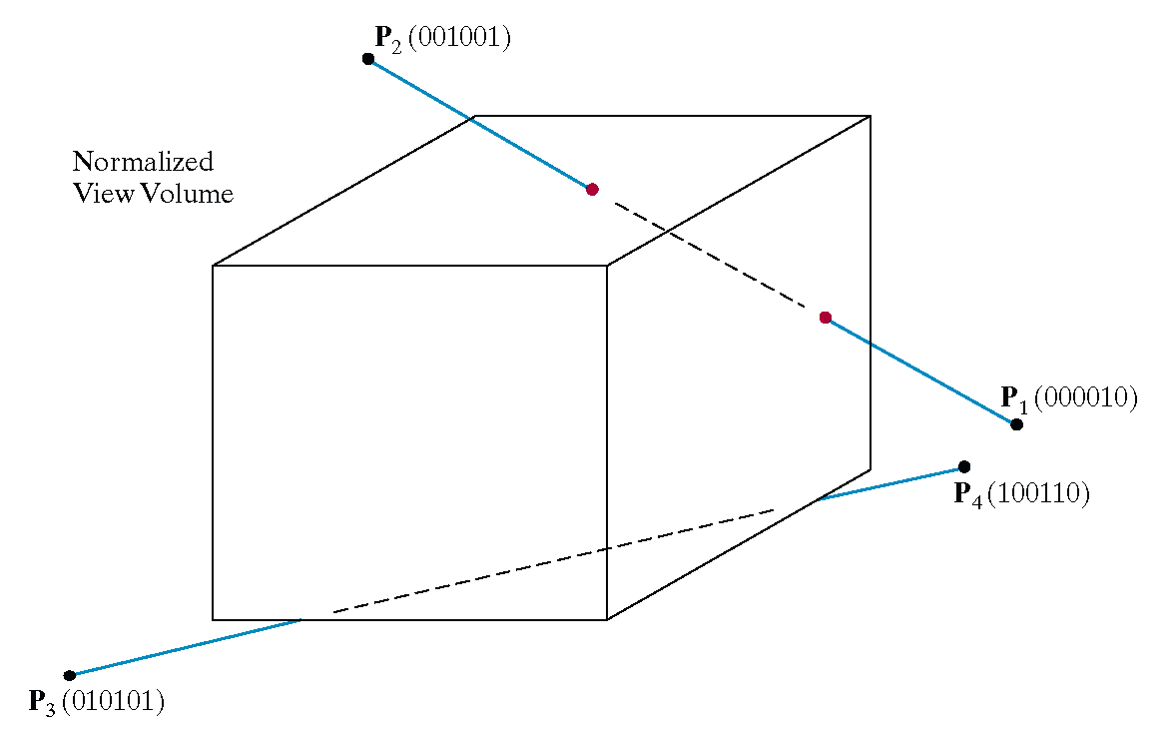
3D Cohen-Sutherland Line Clipping

Slide 13
3D Cohen-Sutherland Line Clipping
For clipping equations for three dimensional line segments are given in their parametric form.
For a line segment with end points P₁(x1_{h}, y1_{h}, z1_{h}, h1) and P₂(x2_{h}, y2_{h}, z2_{h}, h2) the parametric equation describing any point on the line is:
From this parametric equation of a line we can generate the equations for the homogeneous coordinates:

Slide 14

3D Cohen-Sutherland Line Clipping
Consider the line P₁[000010] to P₂[001001]
Because the lines have different values in bit 2 we know the line crosses the right boundary

Slide 15
References
Recommended Books
Text books
1. Donald Hearn and M Pauline Baker, “Computer Graphics C Version”, Pearson Education
Reference Books
1. Amrendra N Sinha and Arun D Udai,” Computer Graphics”, TMH16
2. Steven Harrington, “Computer Graphics: A Programming Approach” , TMH
3. Rogers, “ Procedural Elements of Computer Graphics”, McGraw Hill
Additional online materials
https://www.tutorialspoint.com/computer_graphics/
https://www.inf.ed.ac.uk/teaching/courses/cg/index2018.html
https://nptel.ac.in/courses/106106090/

Slide 16
GALGOTIAS UNIVERSITY
THANK YOU

